Slide 1


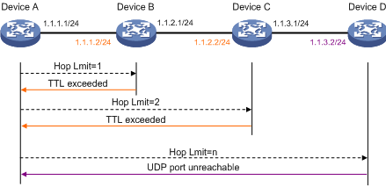


IP Address
Domain Address
Log

